Slide 6
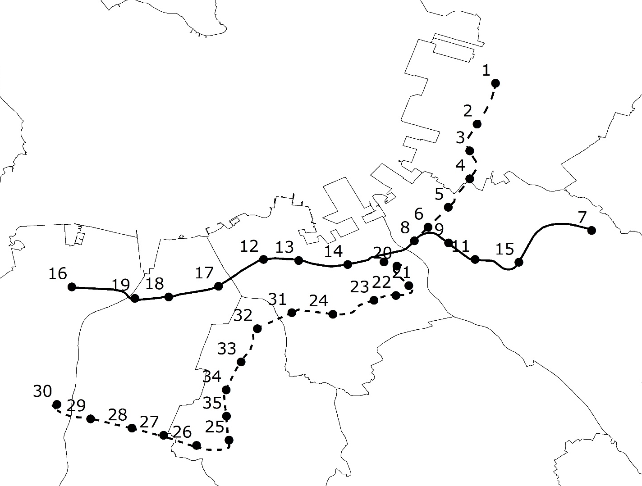
Legend
 | Subway Station
 | Subway Line 1
 | Subway Line 2
 | Subway Line 3
 | District Line
ID | Station | Line |  | ID | Station | Line |  | ID | Station | Line
1 | Kaidzuka | 2 |  | 13 | Ohorikoen | 1 |  | 25 | Fukudaimae | 3
2 | Hakozakikyudaimae | 2 |  | 14 | Akasaka | 1 |  | 26 | Umebayashi | 3
3 | Hakozakimiyamae | 2 |  | 15 | Higashihie | 1 |  | 27 | Noke | 3
4 | Maidashikyudaibyuinmae | 2 |  | 16 | Meinohama | 1 |  | 28 | Kamo | 3
5 | Chiyokenchou | 2 |  | 17 | Nishijin | 1 |  | 29 | Jiromaru | 3
6 | Gofukumachi | 2 |  | 18 | Fujisaki | 1 |  | 30 | Hashimoto | 3
7 | Fukuokakuoko | 1 |  | 19 | Muromi | 1 |  | 31 | Ropponmatsu | 3
8 | Nakasukawabata | 1 |  | 20 | Tenjinminami | 3 |  | 32 | Befu | 3
9 | Gion | 1 |  | 21 | Watanabedori | 3 |  | 33 | Chayama | 3
10 | Tennjin | 1 |  | 22 | Yakuin | 3 |  | 34 | Kanayama | 3
11 | Hakata | 1 |  | 23 | Yakuinodori | 3 |  | 35 | Nanakuma | 3
12 | Tojinmachi | 1 |  | 24 | Sakurasaka | 3

Slide 7
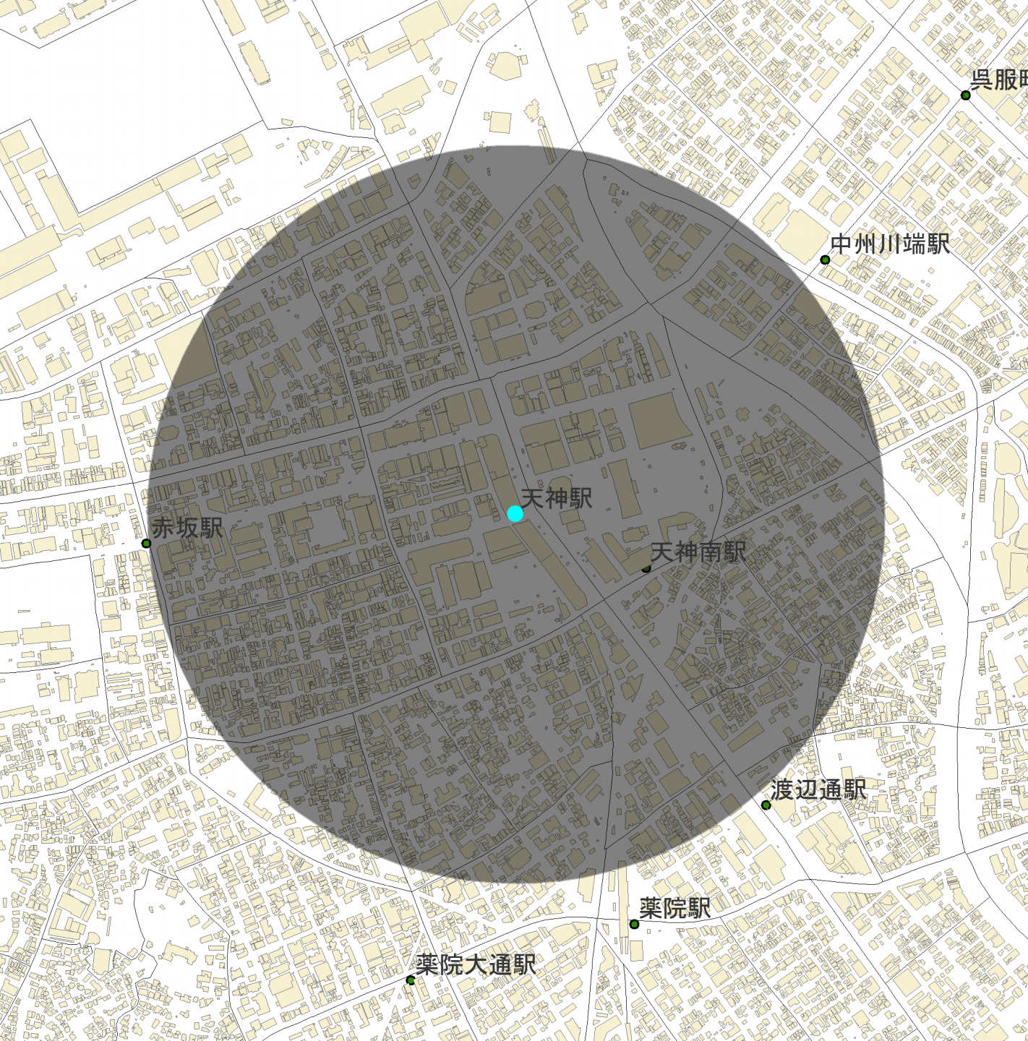

Year | 2008
Station No. | 11
Transit ridership | 108429
Population | 28797
Total building area | 6854646
Office building area | 2100025
Government building area | 197787
… | …
800m

Slide 8
Station No. | Transit ridership on 2010 | Growth rate during 2005-2014 | Line | Station No. | Transit ridership on 2010 | Transit ridership on 2010 | Growth rate during 2005-2014 | Line
10 | 107642 | 1.50% | 1 | 4 | 7116 | 7116 | 3.50% | 2
11 | 90109 | 2.77% | 1 | 32 | 6667 | 6667 | 6.32% | 3
Hub-scale |  |  |  | 2 | 5655 | 5655 | 1.26% | 2
16 | 36664 | 0.69% | 1 | 5 | 5609 | 5609 | 1.94% | 2
7 | 34578 | 1.60% | 1 | 35 | 5324 | 5324 | 7.57% | 3
17 | 33055 | 1.62% | 1 | 31 | 5292 | 5292 | 3.58% | 3
20 | 30874 | 4.16% | 3 | 3 | 5231 | 5231 | 4.03% | 2
Large-scale |  |  |  | 27 | 4771 | 4771 | 4.10% | 3
8 | 22652 | 4.31% | 1 | 6 | 4617 | 4617 | 2.12% | 2
14 | 22090 | 1.61% | 1 | 21 | 4117 | 4117 | 6.64% | 3
18 | 16815 | 1.32% | 1 | 34 | 4052 | 4052 | 3.62% | 3
15 | 14464 | 4.49% | 1 | 23 | 3790 | 3790 | 5.35% | 3
12 | 14247 | 3.12% | 1 | 30 | 3717 | 3717 | 8.04% | 3
1 | 13119 | 1.63% | 2 | 29 | 3471 | 3471 | 4.89% | 3
13 | 12888 | 3.51% | 1 | 28 | 3231 | 3231 | 5.47% | 3
19 | 11419 | 0.90% | 1 | 33 | 2998 | 2998 | 5.52% | 3
22 | 11289 | 4.91% | 3 | 24 | 2327 | 2327 | 6.58% | 3
9 | 10285 | 2.25% | 1 | 26 | 1619 | 1619 | 5.50% | 3
25 | 9269 | 6.08% | 3 | Small-scale
Medium-scale
Transit ridership | Total | Line 1 | Line 2 | Line 3
Hub | 2 | 2 | 0 | 0
Large | 4 | 3 | 0 | 1
Medium | 11 | 8 | 1 | 2
Small | 18 | 0 | 4 | 4
Growth rate | Total | Line 1 | Line 2 | Line 3
0-2.5 | 12 | 8 | 4 | 0
2.5-4.5 | 11 | 5 | 2 | 4
4.5-6.0 | 6 | 0 | 0 | 6
6.0- | 6 | 0 | 0 | 6

Slide 9
Average transit ridership
Average growth rate

Slide 10
Average transit ridership
Average growth rate

Slide 11
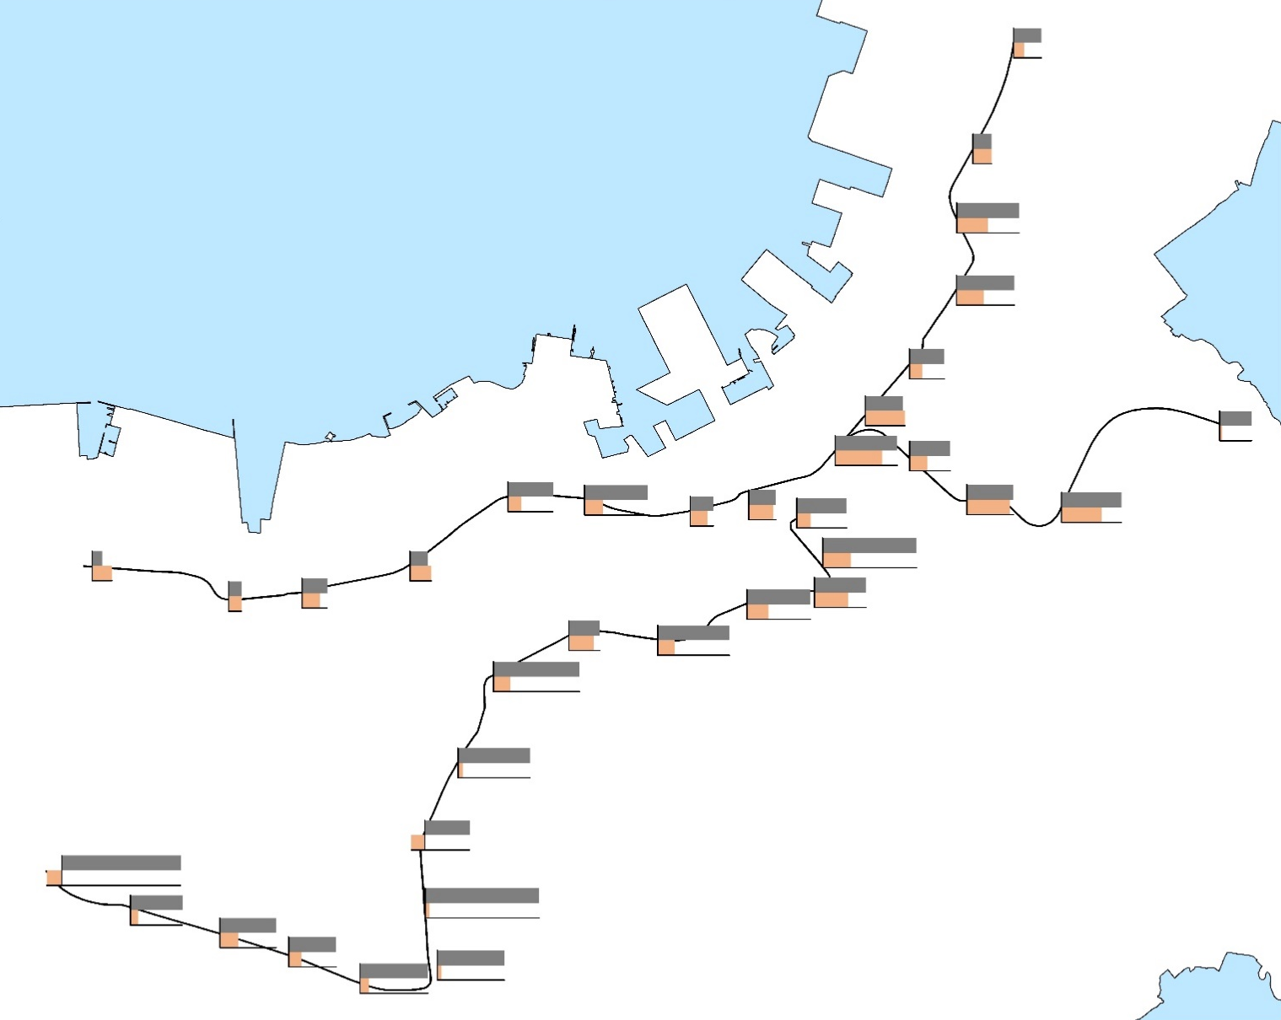
貝塚
18.91%
各駅十年間乗降人員と人口の伸び率
7.04%
箱崎九大前
12.67%
12.62%
H18-H27乗降人員伸び率
箱崎宮前
42.19%
21.05%
H18-H27駅勢圏内の人口伸び率
馬出九大病院前
39.30%
18.43%
千代県庁口
23.45%
呉服町
8.76%
福岡空港
中州川端
25.41%
42.05%
26.92%
唐人町
大濠公園
天神
31.85%
27.43%
21.49%
赤阪
天神南
祇園
12.20%
東比恵
1.54%
33.64%
31.68%
40.58%
姪浜
西新
30.48%
9.35%
29.16%
27.14%
42.88%
15.73%
18.46%
63.64%
博多
6.80%
室見
藤崎
11.93%
9.08%
12.57%
11.74%
16.78%
19.21%
13.45%
14.39%
43.20%
8.76%
17.06%
六本松
14.80%
35.08%
渡辺通
8.98%
12.11%
20.79%
桜坂
22.86%
別府
16.74%
薬院大通
薬院
58.40%
48.61%
11.38%
11.68%
茶山
48.87%
3.16%
橋本
80.61%
金山
30.29%
－10.21%
－9.30%
賀茂
七隈
77.13%
次郎丸
野芥
福大前
2.84%
35.09%
梅林
45.51%
5.21%
38.06%
2.88%
12.29%
32.23%
46.15%
8.59%
6.26%

Slide 12
Subway station
Buffer area

Slide 13
Reserved item
Business
Original data
Filter conditions
Commerce
Hotel
23 types of land use
Entertainment
Residence
1. Have relative larger building area.
Apartment house
2. Commonly exist in most catchment area of subway stations.
Dwelling with shop
Government
Education
Culture

Slide 14
Communalities
 | Initial | Extraction
Business | 1.000 | 0.948
Commerce | 1.000 | 0.887
Hotel | 1.000 | 0.895
Entertainment | 1.000 | 0.745
Residence | 1.000 | 0.976
Apartment | 1.000 | 0.906
Dwelling With Shop | 1.000 | 0.918
Government | 1.000 | 0.813
Education | 1.000 | 0.923
Culture | 1.000 | 0.876
KMO and Bartlett's Test
Kaiser-Meyer-Olkin Measure of Sampling Adequacy. |  | 0.756
Bartlett's Test of Sphericity | Approx. Chi-Square | 346.086
 | df | 45
 | Sig. | 0.000

Slide 15
Type | Station | Population-density | Office | Commerce | Residence | Education
Low-density residence | 30 | 33 | 1.70% | 41.50% | 44.95% | 0.18%
 | 26 | 54 | 2.81% | 1.23% | 58.26% | 2.85%
 | 29 | 78 | 3.02% | 5.40% | 75.86% | 6.94%
 | 27 | 79 | 4.30% | 4.24% | 75.87% | 0.77%
 | 28 | 81 | 3.55% | 3.42% | 73.46% | 6.24%
 | 3 | 91 | 4.01% | 8.58% | 59.97% | 6.25%
 | 33 | 101 | 1.74% | 2.10% | 81.71% | 7.84%
 | 24 | 103 | 2.14% | 2.17% | 66.82% | 8.30%
 | 34 | 109 | 2.38% | 3.28% | 86.12% | 0.86%
 | Average | 81 | 2.85% | 7.99% | 69.23% | 4.47%
High-density residence | 19 | 121 | 2.17% | 3.15% | 76.63% | 0.12%
 | 13 | 125 | 11.11% | 6.48% | 46.08% | 4.51%
 | 16 | 142 | 4.59% | 5.03% | 72.75% | 2.68%
 | 18 | 142 | 2.27% | 1.96% | 64.58% | 6.80%
 | 31 | 143 | 4.14% | 2.26% | 54.17% | 18.28%
 | 17 | 144 | 6.02% | 7.28% | 55.45% | 10.60%
 | 12 | 145 | 4.16% | 1.77% | 66.22% | 4.39%
 | 32 | 170 | 1.17% | 1.28% | 73.54% | 9.93%
 | 23 | 193 | 10.00% | 6.18% | 44.52% | 2.56%
 | Average | 151 | 5.43% | 4.03% | 59.66% | 7.47%
Education | 25 | 35 | 1.38% | 2.31% | 30.04% | 39.83%
 | 1 | 56 | 8.70% | 1.91% | 48.01% | 17.89%
 | 35 | 58 | 5.63% | 3.78% | 55.18% | 21.37%
 | 4 | 67 | 4.93% | 3.49% | 33.52% | 14.63%
 | 2 | 77 | 4.03% | 11.75% | 44.03% | 23.24%
 | 5 | 89 | 11.53% | 7.26% | 30.51% | 7.30%
 | Average | 64 | 6.03% | 5.08% | 40.22% | 20.71%
Downtown commerce | 9 | 64 | 44.97% | 20.55% | 10.62% | 0.70%
 | 20 | 67 | 34.60% | 36.74% | 11.34% | 1.26%
 | 8 | 67 | 42.97% | 27.86% | 12.23% | 0.59%
 | 11 | 79 | 37.12% | 17.38% | 18.47% | 1.89%
 | 10 | 92 | 30.76% | 26.26% | 15.72% | 1.74%
 | Average | 74 | 38.08% | 25.76% | 13.68% | 1.24%
Office | 15 | 64 | 31.63% | 7.80% | 25.80% | 5.73%
 | 6 | 96 | 34.56% | 17.29% | 21.61% | 1.75%
 | 14 | 105 | 26.97% | 17.27% | 17.61% | 2.80%
 | 21 | 136 | 22.86% | 16.12% | 33.66% | 2.70%
 | 22 | 167 | 21.38% | 12.53% | 36.79% | 2.50%
 | Average | 114 | 27.48% | 14.20% | 27.09% | 3.10%
Airport | 7 | 19 | 3.55% | 1.45% | 33.45% | 1.25%
Pie chart of land use type

Slide 16
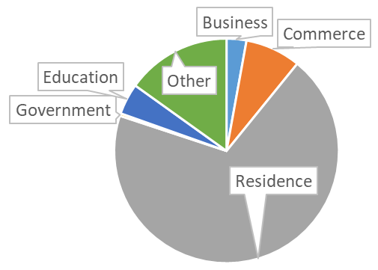
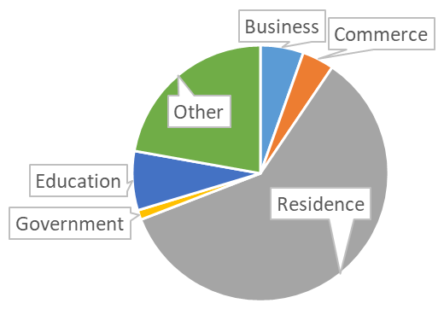
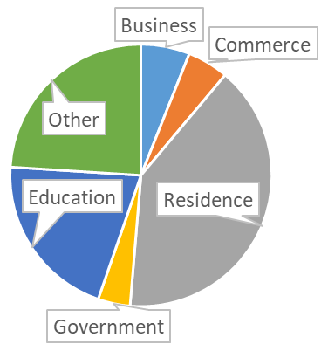
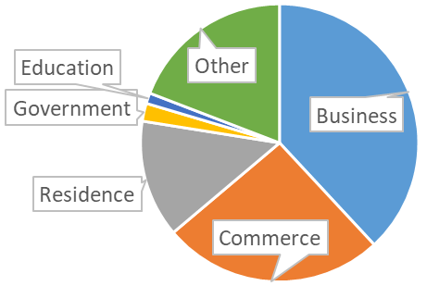
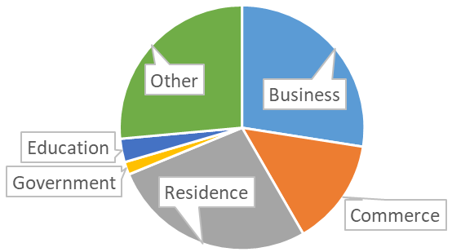
Type | Station | Population-density | Business | Commerce | Residence | Government | Education
Low-density residence | 30 | 33 | 1.70% | 41.50% | 44.95% | 0.01% | 0.18%
 | 26 | 54 | 2.81% | 1.23% | 58.26% | 0.00% | 2.85%
 | 29 | 78 | 3.02% | 5.40% | 75.86% | 0.00% | 6.94%
 | 27 | 79 | 4.30% | 4.24% | 75.87% | 0.07% | 0.77%
 | 28 | 81 | 3.55% | 3.42% | 73.46% | 0.03% | 6.24%
 | 3 | 91 | 4.01% | 8.58% | 59.97% | 3.04% | 6.25%
 | 33 | 101 | 1.74% | 2.10% | 81.71% | 0.00% | 7.84%
 | 24 | 103 | 2.14% | 2.17% | 66.82% | 0.10% | 8.30%
 | 34 | 109 | 2.38% | 3.28% | 86.12% | 0.01% | 0.86%
 | Average | 81 | 2.85% | 7.99% | 69.23% | 0.36% | 4.47%
High-density residence | 19 | 121 | 2.17% | 3.15% | 76.63% | 2.77% | 0.12%
 | 13 | 125 | 11.11% | 6.48% | 46.08% | 1.29% | 4.51%
 | 16 | 142 | 4.59% | 5.03% | 72.75% | 1.43% | 2.68%
 | 18 | 142 | 2.27% | 1.96% | 64.58% | 4.81% | 6.80%
 | 31 | 143 | 4.14% | 2.26% | 54.17% | 0.51% | 18.28%
 | 17 | 144 | 6.02% | 7.28% | 55.45% | 0.74% | 10.60%
 | 12 | 145 | 4.16% | 1.77% | 66.22% | 0.19% | 4.39%
 | 32 | 170 | 1.17% | 1.28% | 73.54% | 0.73% | 9.93%
 | 23 | 193 | 10.00% | 6.18% | 44.52% | 0.04% | 2.56%
 | Average | 151 | 5.43% | 4.03% | 59.66% | 1.22% | 7.47%
Education | 25 | 35 | 1.38% | 2.31% | 30.04% | 0.00% | 39.83%
 | 1 | 56 | 8.70% | 1.91% | 48.01% | 0.53% | 17.89%
 | 35 | 58 | 5.63% | 3.78% | 55.18% | 0.07% | 21.37%
 | 4 | 67 | 4.93% | 3.49% | 33.52% | 13.55% | 14.63%
 | 2 | 77 | 4.03% | 11.75% | 44.03% | 0.81% | 23.24%
 | 5 | 89 | 11.53% | 7.26% | 30.51% | 8.90% | 7.30%
 | Average | 64 | 6.03% | 5.08% | 40.22% | 3.98% | 20.71%
Downtown commerce | 9 | 64 | 44.97% | 20.55% | 10.62% | 2.17% | 0.70%
 | 20 | 67 | 34.60% | 36.74% | 11.34% | 3.01% | 1.26%
 | 8 | 67 | 42.97% | 27.86% | 12.23% | 0.16% | 0.59%
 | 11 | 79 | 37.12% | 17.38% | 18.47% | 2.50% | 1.89%
 | 10 | 92 | 30.76% | 26.26% | 15.72% | 2.55% | 1.74%
 | Average | 74 | 38.08% | 25.76% | 13.68% | 2.08% | 1.24%
Business | 15 | 64 | 31.63% | 7.80% | 25.80% | 4.39% | 5.73%
 | 6 | 96 | 34.56% | 17.29% | 21.61% | 0.10% | 1.75%
 | 14 | 105 | 26.97% | 17.27% | 17.61% | 3.74% | 2.80%
 | 21 | 136 | 22.86% | 16.12% | 33.66% | 0.16% | 2.70%
 | 22 | 167 | 21.38% | 12.53% | 36.79% | 0.04% | 2.50%
 | Average | 114 | 27.48% | 14.20% | 27.09% | 1.69% | 3.10%
Airport | 7 | 19 | 3.55% | 1.45% | 33.45% | 0.03% | 1.25%
Pie chart of land use type

